Slide 1
Understanding Machine vs Human Generated Text in News
Group10:
Raakesh Sureshkumar
Dunchuan Wu

Slide 2
Objectives
Phase 1
Collect / scrape human written text on news article websites
Using the same headlines that are given for the news articles, automate the process of text generation for those headline
Compare the differences between the human generated and the machine generated text
Phase 2
Use an existing textual dataset that contains the labels for the classes of human and machine generated text.
On this dataset perform a supervised learning to classify the human vs machine generated text.
Analyze the model used and infer from the results

Slide 3
Dataset creation (Phase 1)
Automation tools used
Selenium
Chrome web driver
GPT-2
OpenAI API
Programming language
Python
News article websites
CNN
NYTimes

Slide 4
Deep neural network text classification with pre-trained word embeddings
Step 1: Preprocessing of the text
Tokenization
Lemmatization / Stemming
Stopwords
Word Contractions
Noise Removal

Slide 5
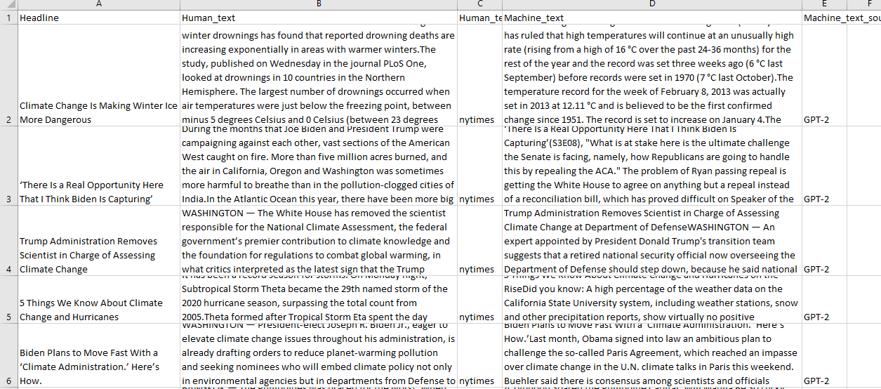
Result Phase 1

Slide 6
Inference (Phase 1)
Sentence formation
Probability for a change in sequence
Redundancy
N-gram approach interference

Slide 7
Model developed (Phase 2)
Feature Extraction
i. TfIdf vectorizer
ii. GloVe word embedding
Convolutional Neural Network:
i. Embedding layer
ii. 1D Convolution layer
iii. Maxpool layer
iv. Dense layers (ReLU activated)
v. Dense layer (Softmax)
Word Preprocessing: i. Stop word removal
ii. lower case conversion

Slide 8
Feature Extraction and Vectorization
Count vectorizers
Term frequency Inverse document frequency vectorizer
Using pre-trained word embedding models
Glove
Word2Vec
FastText

Slide 9
Supervised learning models used
Linear SVC
Logistic regression
Naïve Bayes
CNN
Other models studied:
RNN / LSTMs
Transformers

Slide 10
Hyper-parameter tuning
RandomizedCV
GridSearch

Slide 11
Dataset used
Tweepfake (Used for training)
Phase 1 news articles
A collection Kaggle news articles

Slide 12
Results phase 2 (Tweepfake trained model)
Model / Accuracy | Training accuracy | Testing Accuracy
Linear Support Vector Classifier | 99.89% | 72.53%
Naïve Bayes | 97.71% | 70.31%
Logistic Regression | 95.75% | 73.83%
Perceptron (TfIdf vectorizer) | 99.94% | 71.61%
Perceptron (Count vectorizer) | 99.94% | 69.53
DNN with embedding layer and maxpool | 100% (overfit) | 71.35%
Convolutional Neural Network (Without GloVe embedded training) | 51.62% | 50.26%
Convolutional Neural Network (GloVe embedded training) | 55.87 | 54.17

Slide 13
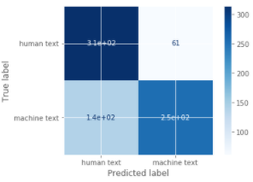
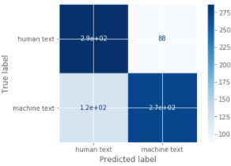
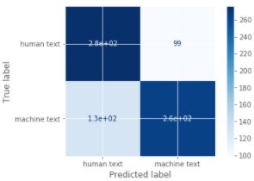
Confusion matrices
Logistic regression
Linear SVC
Naïve Bayes

Slide 14
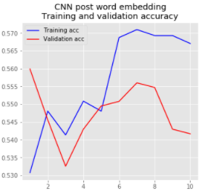
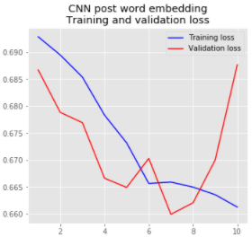
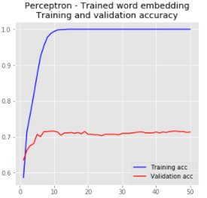
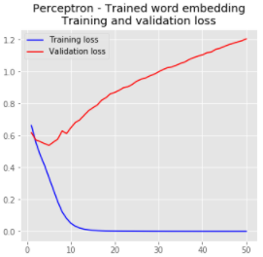
Accuracy and Loss plot for train vs validation set for CNN
Convolutional Neural Network
Single layer Neural Network
Accuracy
Loss
Accuracy
Loss

Slide 15
Inference phase 2
Effectiveness of a DNN like a CNN
Best supervised learning model from the observed – Logistic regression
Other recent state-of-the-art models (out of scope)
LSTMs / RNNs
Transformer based
BERT
GPT-2

